Slide 1
Selective Parity Protection for Resilient Low-Voltage SRAM in Quantized Neural Networks
Oğulcan Aşık, Ji Wu, Kazuteru Namba
Chiba University

Slide 2
Motivation
Large AI Models
Problem 1: High Energy Requirement
Problem 2: High Accuracy Requirement
  Need to Balance Both
What can we do about this?

Slide 3
Common Solutions
Quantization
  Impact on Accuracy Depends on Method Used
Lowering Operating Voltage
  Increases Bit Error Rate (BER) Which Lowers Accuracy
Smaller Models
  Not Acceptable in Many Use Cases
Mixed-Precision Training
  Very Effective Reduction of Precision in Steps Where Higher Precision is not Needed
Sparse Models
  Activating Only Certain Areas in a Model Depending on the Query
Hardware Advancements like CIM
  RAM That Can Perform Certain Computations In-Memory Saving Expensive Data Transfers

Slide 4
Methodology
ECC + Quantized Models = Lower Operating Voltage
Core Idea:
  Train CNN With 32-Bit Weight
    Quantize Weights to 4-Bit, 8-Bit & 16-Bit
  Apply Error Correcting Code (ECC) to SRAM with Low Operating Voltage
  Low Operating Voltage = Higher Bit Error Rate
  Use ECC to Correct up to 1 Bit Error in Every Model Weight
Two Methods:
  Split Bit Ranges in a Word to protected (BER = 10⁻⁴) and unprotected (variable BER)
  Same BER throughout the entire Word

Slide 5
Methodology
Quantize
MSB LSB
32-bit
16-bit
8-bit
4-bit
use Hamming Code to protect LSB
No Splitting of bits
Hamming Code
Number of Parity depends on the number of protected bits:
1-4 data bits require 3 parity bits,
5-11 data bits require 4 parity bits
12-16 data bits require 5 parity bits
4-bit
8-bit
use Hamming Code to protect all bits
16-bit

Slide 6
Methodology: CNN
Conv
Input
ReLU
MaxPool
LeNet5
Trained on MNIST dataset
number of steps: 2000
batch size: 500
Originally 32-bit weights
Output
Conv
SoftMax
ReLU
FC
MaxPool
ReLU
Conv
FC
ReLU

Slide 7
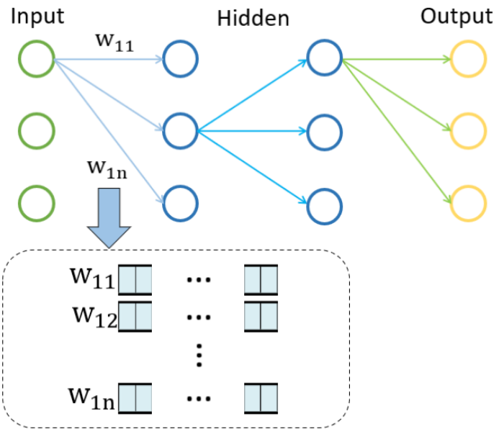
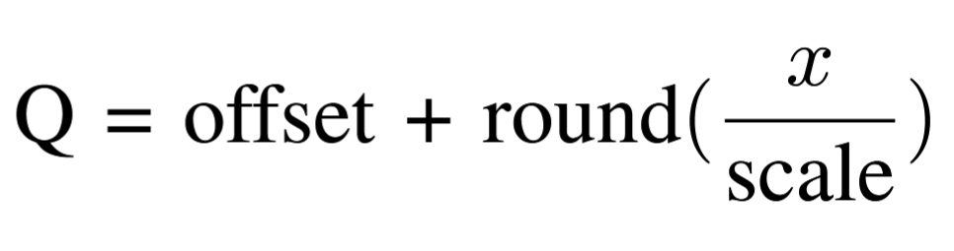
Methodology: Quantization
3 Quantizations of the Weights:
  16-Bit
  8-Bit
  4-Bit
Edited Image from J. Wu and K. Namba, “Sram-based efficiency memory model for quantized convolutional neural networks,” in 2023 International Conference on Consumer Electronics - Taiwan (ICCE-Taiwan), 2023, pp. 499–500.

Slide 8
Methodology: ECC – Hamming Code Correction
4-bit Example:
Set parity to 1 if odd:
1 | 2 | 3 | 4 | 5 | 6 | 7
Parity 1 | Parity 2 | Data 1 | Parity 4 | Data 2 | Data 3 | Data 4
0 | 1 | 1 | 1 | 1 |  | 0
P1 1 1 0 => P1 = 0
P2 1 0 0 => P2 = 1
P4 1 0 0 => P4 = 1

Slide 9
Methodology: ECC – Hamming Code Correction
Error
4-bit Example:
Check if even:
1 | 2 | 3 | 4 | 5 | 6 | 7
Parity 1 | Parity 2 | Data 1 | Parity 4 | Data 2 | Data 3 | Data 4
0 | 1 | 1 | 1 | 1 | 1 | 0
P1: 0 1 1 0 is even => OK
P2: 1 1 1 0 is odd => Error!
P4: 1 1 1 0 is odd => Error! Position found!
=> Error Position = 2 + 4

Slide 10
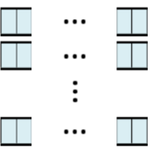

Methodology: Bit Error Simulation
[
]
Convert Model Weights to Bit Arrays
Generate Random Bit Mask According to The Resulting Size and BER
Flip Bits Using Bit Mask
Convert Bit Array Back into Model
[
]
Weights
In Model
[
]
[
]
1. Convert data
4. Convert Back
[
]
[
]
[
]
3. Flip Bits
[
]
[
]
[
]
[
]
[
]
[
]
[
]
[
]
[
]
[
]
[
]
[
]
[
]
[
]
[
]
[
]
[
]
2. Generate Random Bit Flip Mask
Weights as Bit Array

Slide 11

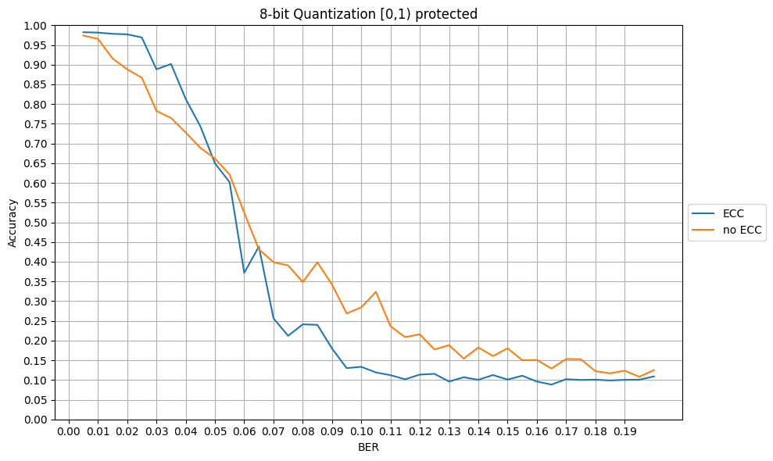
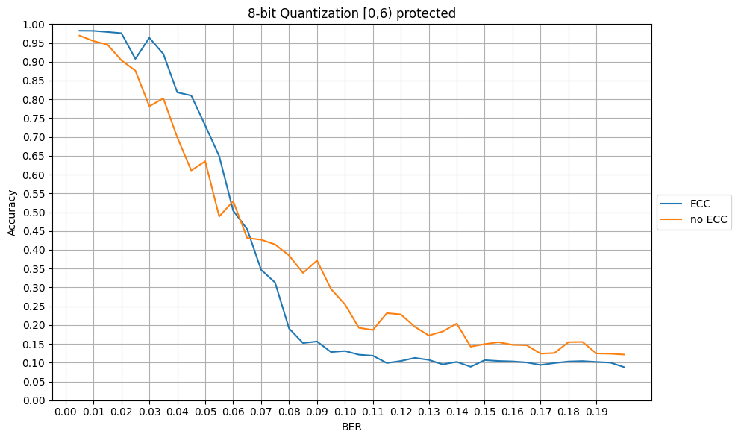
Results: 8-Bit with Split BERs
8-bit Quantization [0,1) protected
8-bit Quantization [0,6) protected
Accuracy
Accuracy
BER
BER
[0,1) indicates that bit 0 only is protected, with [0,6) it is 0, 1... 5
ECC allows increasing the BER up to 0.025 with minimal accuracy cost

Slide 12
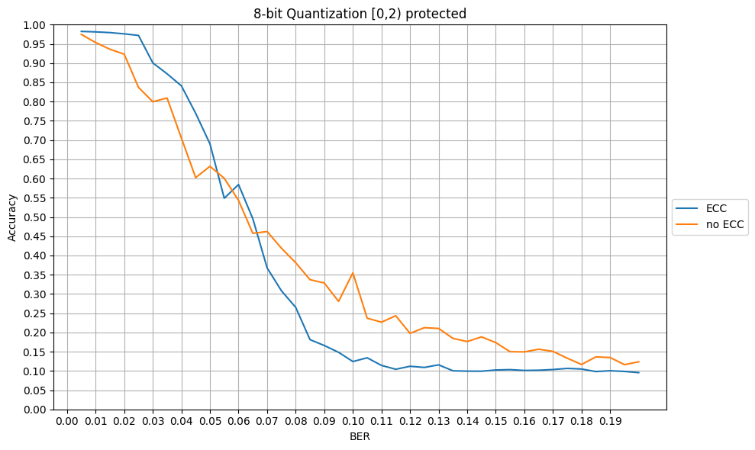
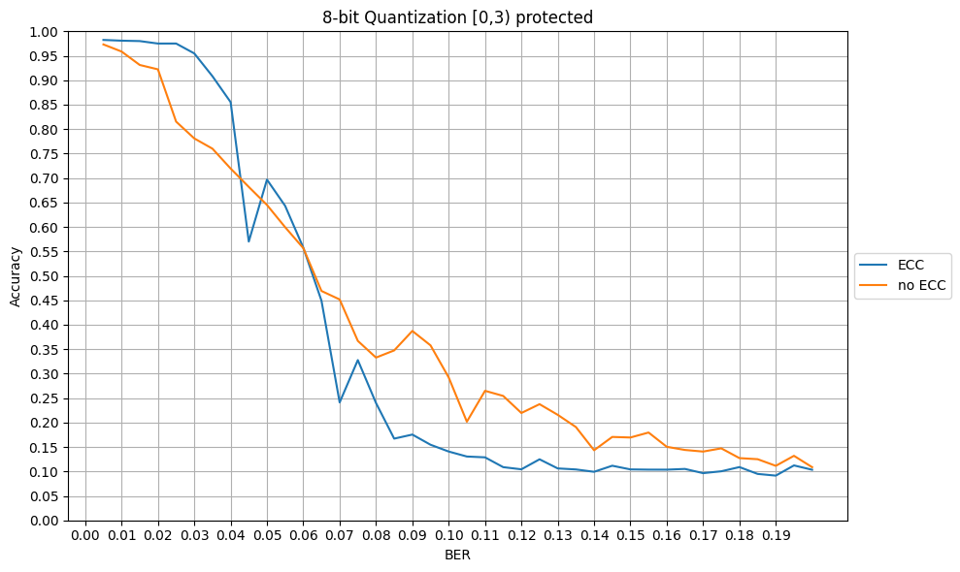
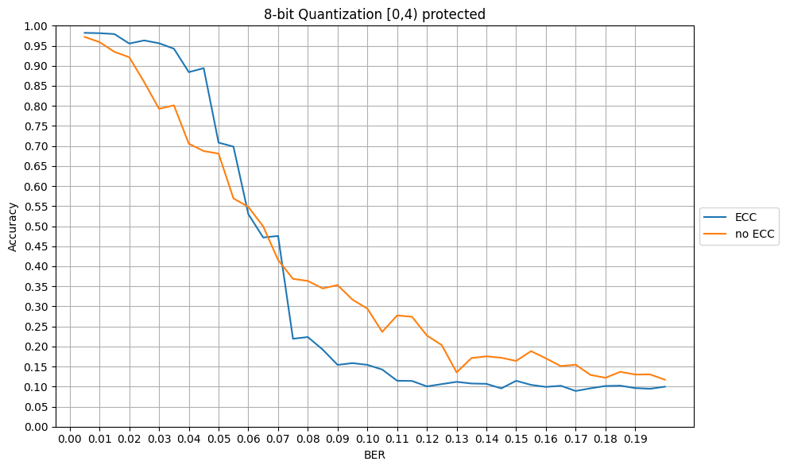
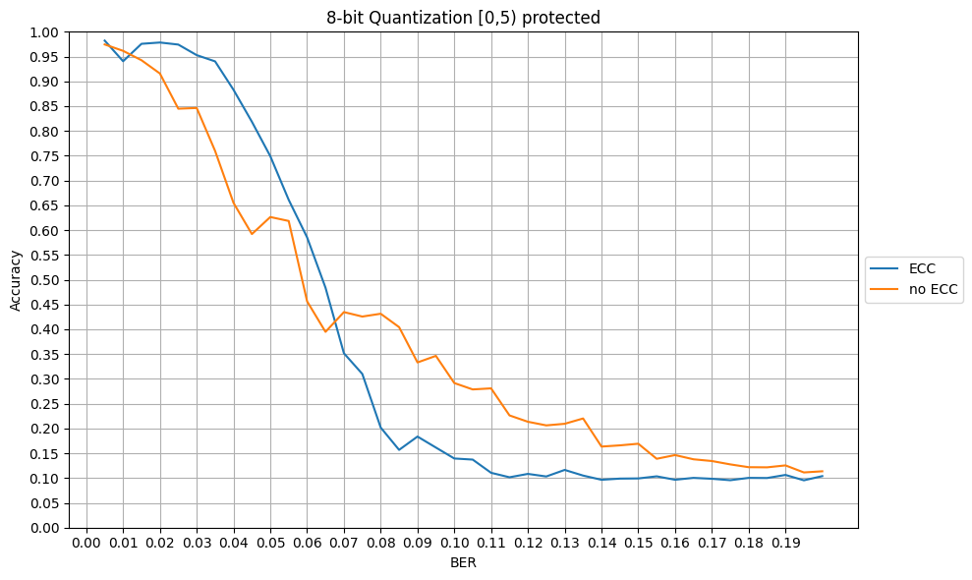
Results: 8-Bit with Split BERs

Slide 13
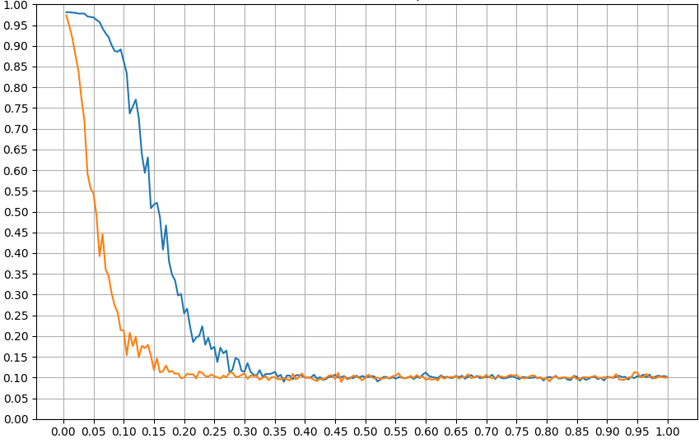
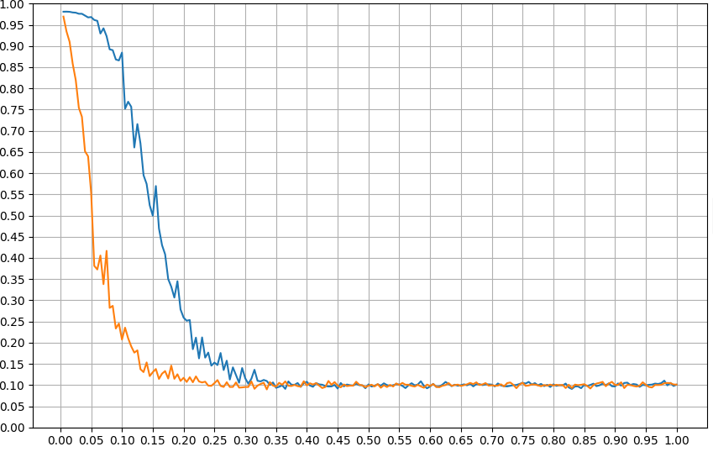
Results: 4-Bit with Split BERs
4-bit Quantization [0,1) protected
4-bit Quantization [0,2) protected
Accuracy
Accuracy
BER
BER
ECC allows increasing the BER up to 0.05 with minimal accuracy cost

Slide 14
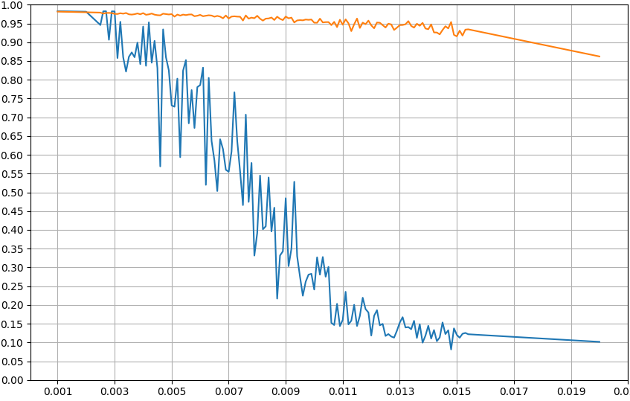
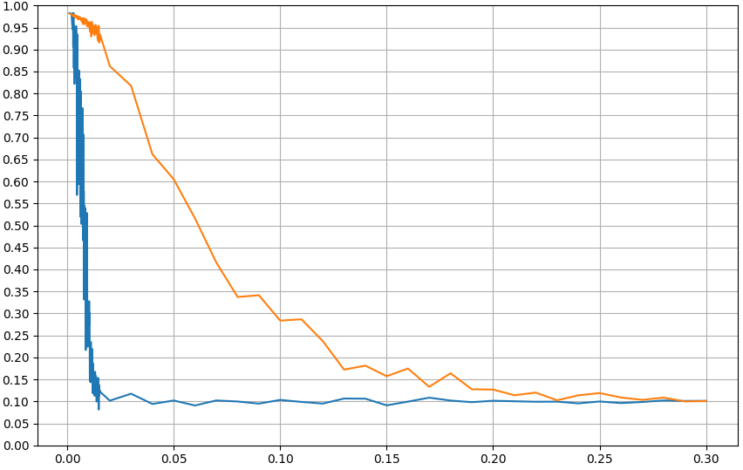
Results: 16-Bit with Same BERs
16-bit Quantization No Protected Bits
16-bit Quantization No Protected Bits
Accuracy
Accuracy
BER
BER
Accuracy worsened by ECC
BER up to 0.003

Slide 15
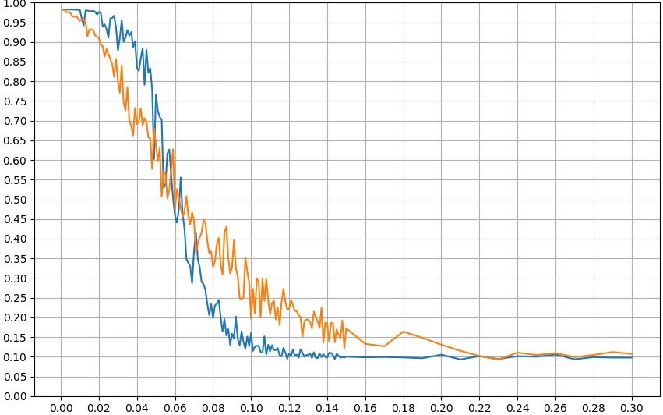
Results: 8-Bit with Same BERs
8-bit Quantization No Protected Bits
Accuracy
BER
ECC allows increasing the BER up to 0.025 with minimal accuracy cost

Slide 16
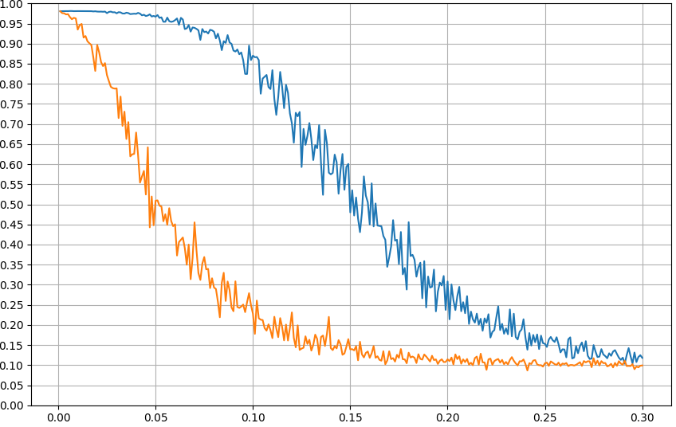
Results: 4-Bit with Same BERs
4-bit Quantization No Protected Bits
Accuracy
BER
ECC allows increasing the BER up to 0.05 with minimal accuracy cost

Slide 17
Results: Potential Energy Saving¹
Split BER:
Same BER:
L. Yang and B. Murmann, "SRAM voltage scaling for energy-efficient convolutional neural networks," 2017 18th International Symposium on Quality Electronic Design (ISQED), Santa Clara, CA, USA, 2017, pp. 7-12, doi: 10.1109/ISQED.2017.7918284.¹
 | Unprotected | 8-Bit | 4-Bit
Voltage | 0.54V | 0.49V | 0.47V
BER | 10⁻⁴ | 0.025 | 0.05
 | 16-Bit (no ECC) | 8-Bit | 4-Bit
Voltage | 0.51V | 0.49V | 0.47V
BER | 0.003 | 0.025 | 0.05

Slide 18
Conclusion
ECC allows higher BERs without sacrificing model accuracy
Cost and Effort of Splitting up Operating Voltages is not worth it
Most effective Energy Saving via low bit count combined with ECC method
ECC + Quantization makes Energy Saving without significant Accuracy loss possible

Slide 19
Thank You For Listening

